Slide 2
One Emory: Ambition and Heart is a strategic framework that will guide Emory into a bold future. It is focused on strengthening all of Emory’s nine schools, making the university an unparalleled destination for education, elevating Emory’s world-class academic health system, and recommitting to Emory staff and the city of Atlanta.

Slide 3

ONE EMORY: THEN AND NOW

Slide 4
Faculty Eminence
Academic Community of Choice
Innovation through Scholarship and
Creative Expression
Thriving Health Care, Inventing Cures
Commitment to Our People
Emory + Atlanta: Rich History, Shared Future

Slide 6

FACULTY EMINENCE
Foster a culture of eminence that attracts and inspires scholars of the highest order
Emory attracts the brightest minds in academia. Our faculty pursue
game-changing, breakthrough research that consistently achieves positive impact in the world. They embrace new technologies in the classroom and inspire students to be active learners, equipped to discover for themselves. At Emory, research, scholarship, teaching,
and mentoring are all part of a singular mission to create an inquiry-driven, dynamic, and diverse intellectual community.

Slide 7

FACULTY EMINENCE
GOALS
Sustain intellectual leadership across all programs and research disciplines while elevating the competitive position of targeted areas.
Cultivate world-class faculty scholars committed to enriching and engaging the Emory community and beyond.
Achieve excellence as an intellectual community built on a diverse faculty and an inclusive culture.

Slide 9
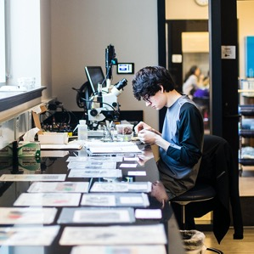
ACADEMIC COMMUNITY OF CHOICE
Cultivate a thriving campus and a compelling student experience
As an academic community of choice, we practice the values of intellectual rigor, integrity, risk taking, and collaboration. Our faculty and students pursue open inquiry across disciplines—guided by evidence, committed to critical inquiry, fueled by the creative spirit, and dedicated not only to discovery in its own right but to solving problems and serving society.

Slide 10

ACADEMIC COMMUNITY OF CHOICE
GOALS
Offer the most inclusive and financially accessible higher education experience among the nation’s top universities.
Transform Emory’s undergraduate campus life experience to create a connected, living, impact-oriented intellectual community.
Become the most influential institution in our students’ lives by cultivating affinity for Emory.

Slide 12
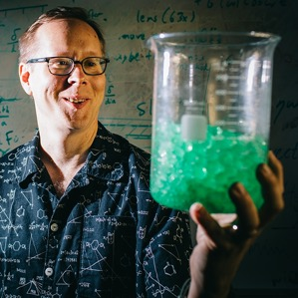
INNOVATION THROUGH SCHOLARSHIP AND CREATIVE EXPRESSION
Harness imagination and discovery to address 21st-century challenges
Innovation through scholarship and creative expression drives our thriving research enterprise. With the liberal arts permeating all that we do, we prepare students to be critical thinkers and to lead lives of meaning and consequence. As a community of thought leaders and culture producers, we are dedicated to advancing discoveries and innovation across the disciplines and the professions for the public good and to providing opportunities for research in all disciplines and self-discovery among our students.

Slide 13

INNOVATION THROUGH SCHOLARSHIP AND CREATIVE EXPRESSION
GOALS
Be a top-ranked global leader in health science research to drive societal impact.
Be the preeminent destination for innovative arts leaders.
Become an innovative research leader in the humanities as well as the natural and social sciences.

Slide 15

THRIVING HEALTH CARE, INVENTING CURES
Improve the health of individuals and communities at home and throughout the world.
From clinical frontline workers, physicians, and nurses to the public health practitioners and researchers who improve health and well-being and develop cutting-edge treatments to eradicate disease, Emory’s Woodruff Health Sciences Center and health care enterprise serve our region and society in unparalleled ways. At all stages of the lifecycle, Emory and its vital institutional, teaching, and research partners in Atlanta, and across the state and the world, seek solutions to humanity’s most challenging health issues.

Slide 16

THRIVING HEALTH CARE, INVENTING CURES
GOALS
Invent novel ways to prevent and treat disease through discovery and innovation.
Engage in culturally sensitive scholarship that advances health and well-being.
Prepare the next generation of scientists, health care providers, and public health practitioners to save and improve lives

Slide 18

COMMITMENT TO OUR PEOPLE
Celebrate and support the people who power our campuses and health care facilities
We cannot lead, much less compete, on a global scale in education, research, and health care without a skilled and motivated workforce. Our staff has an essential role in bringing to life all aspects of Emory, from facilities and food services to accounting, EPD, maintenance, IT, and everything in between. We are committed to ensuring these important people of our university are celebrated, given career pathways, and inspired to grow and develop.

Slide 19

COMMITMENT TO OUR PEOPLE
GOALS
Prioritize the contributions, needs, and goals of the workforce that powers everything.
Ensure attainable pathways to career satisfaction and success for our staff members.
Set the standard for a culture of development and growth.

Slide 21

EMORY + ATLANTA: RICH HISTORY, SHARED FUTURE
Unleash the collaborative and strategic partnership of Emory and Atlanta
Atlanta—a renowned cultural, logistics, technology, transportation, and business hub—is a destination for our faculty, staff, and students and a launchpad for new ideas and developments. By building on our alliance and deepening our engagement with our home city, students and faculty can work to solve the most pressing issues of our time in a community that embraces diversity and dialogue. In innumerable ways, we draw strength from Atlanta and add to its richness.

Slide 22
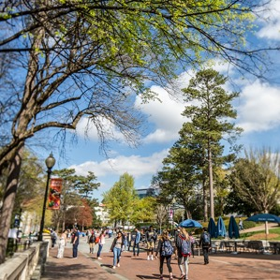
EMORY + ATLANTA: RICH HISTORY, SHARED FUTURE
GOALS
Unlock Emory and Atlanta’s shared potential as an engine for inclusive growth.
Realize Emory as a core part of the civic fabric of Atlanta.
Serve Atlanta and global communities by bringing to bear strengths as a top-tier research institution in partnership with innovative Atlanta institutions.

